Slide 1



Analysis & Results 4th Challenge
TechnoReady In-Mexico.
Iván Kaleb Ramírez Torres, NAO ID: 3357
Notes:
Title: Include the name of the company featured in the challenge along with some general information

Slide 2

About Digital NAO
It's a program created by Tecmilenio University that identifies the digital skills most in demand by companies, co-created with industry experts and challenges based on real-life situations.

Slide 3
Tattler: a Mexican company that offers a nationwide restaurant directory
Tattler is facing a major challenge: User traffic has dropped drastically, affecting the platform’s effectiveness.
Possible cause: Tattler’s directory is not up to date.
The project consists of transforming a restaurant directory platform to offer users a personalized and dynamic experience.

Slide 4
Proposed solution
Use MongoDB to manage the restaurant database and develop a REST API with Express.js that allows users to interact dynamically with the application creating endpoints for adding comments, rating and registering new restaurants, as well as searching and filtering information.
Improving significantly the user experience and keeping the directory’s content constantly updated.

Slide 5
Objectives
Sprint 1: Setting up and developing a database in MongoDB, creating a database backup file, including collections and import scripts from CSV files.
Sprint 2: Develop a RESTful API using Express.js and MongoDB, conducting tests in Postman to verify the proper functioning of the API.
Sprint 3: Develop new functionalities for the RESTful API by adding search and filtering capabilities, conducting tests in Postman to demonstrate the functionality of these new features.
Notes:
Problem context: Define the identified need including examples and market análisis

Slide 6

Roadmap
Notes:
Roadmap: Include road map you created in sprint one. Make sure it includes Project objectives, deliverables and stages

Slide 7
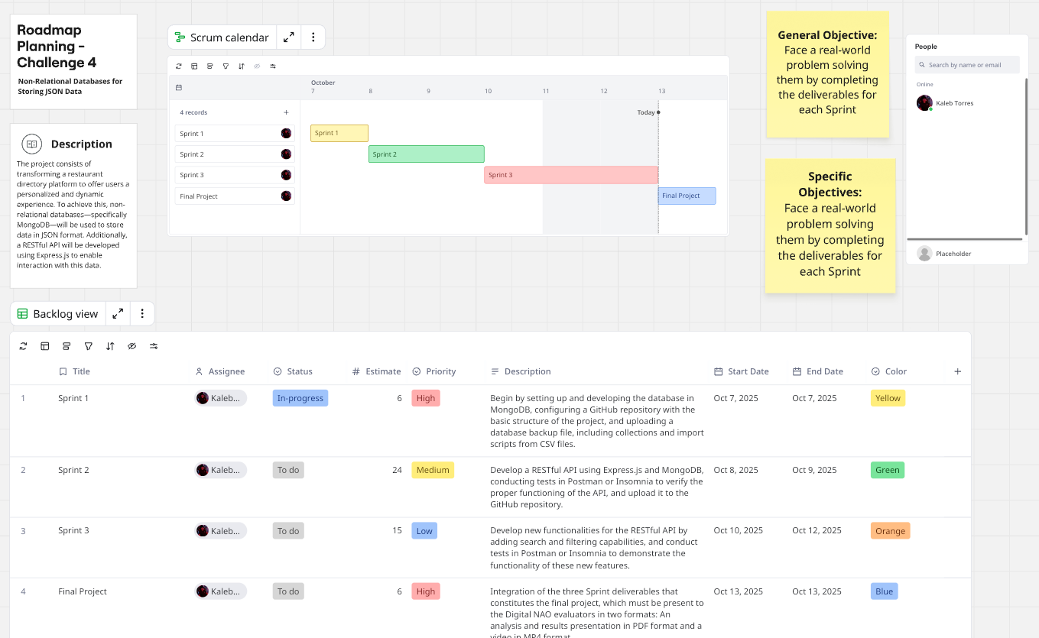

Slide 8

Backlog
Notes:
Backlog: Add the backlog you created and update it during the each sprint

Slide 9
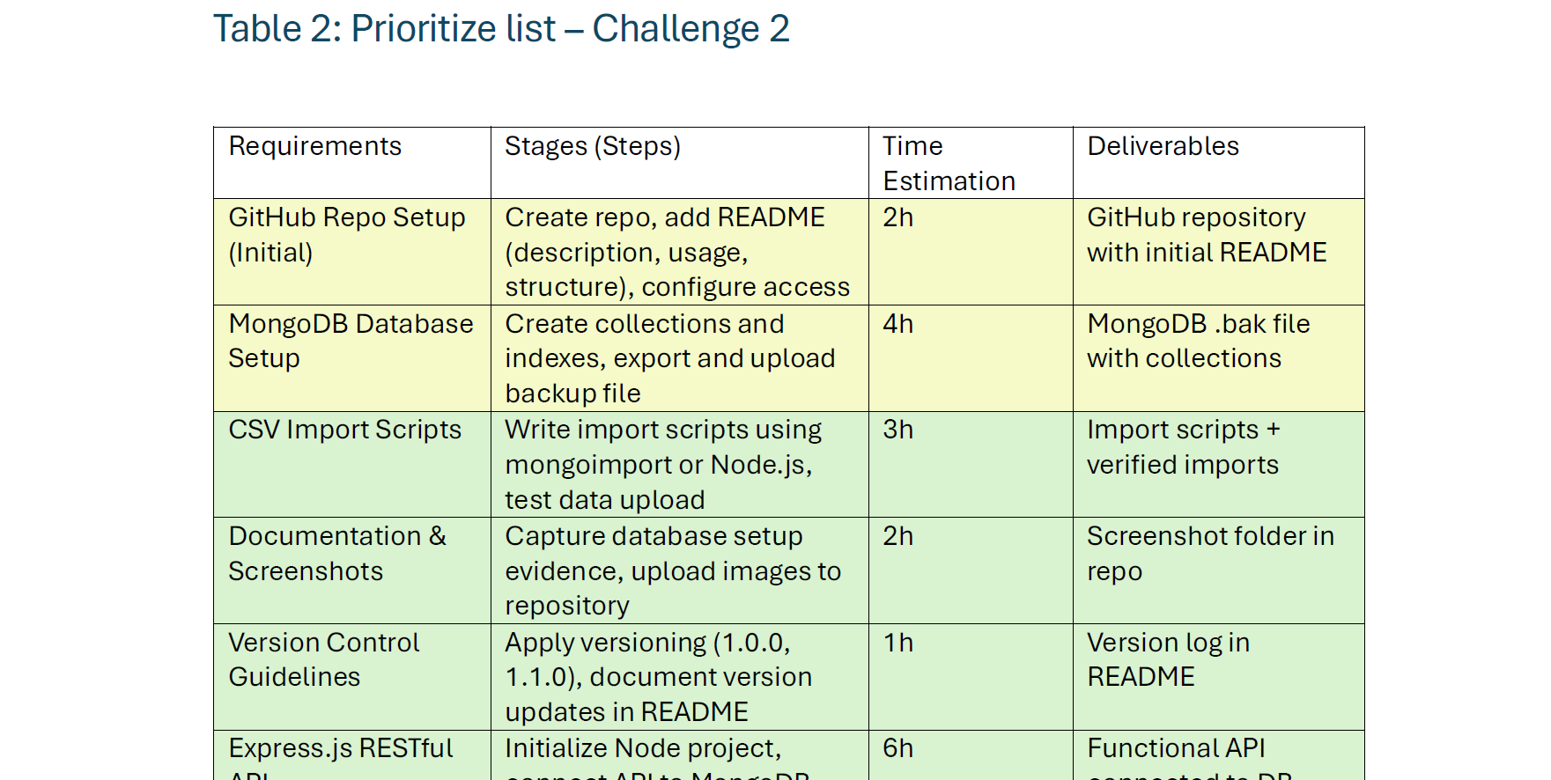

Slide 10

Sustainability
🌿 1. Efficient Resource Use
🧩 2. Reusability and Modularity
⚙️ 3. Lightweight Infrastructure
🌍 4. Open Knowledge and Educational Impact

Slide 11

Green Software Practices Applied
Do no extra work
Measure → Reduce: track runs & API calls
Batch & cache where feasible
Fail fast on HTTP 429/4xx to avoid loops
Right-size storage: text fields only; avoid blobs
Automate cleanup (ID normalization)

Slide 12
Scalability by Design
Stateless importer: run on-demand, parallelize by author list (N authors → N workers).
Storage abstraction: start with SQLite → switchable to PostgreSQL/MySQL if volume grows.
Idempotent writes: UNIQUE(researcher_id, title) enables safe re-runs at scale.
Incremental fetch: import only new/updated items (cache last-run timestamp).

Slide 13

Economic Viability (Run-Costs & Efficiency)
Run-cost profile
API calls per run: ~2 (2 authors × 1 request) → near $0 on free tier; light paid tier ≈ $50/mo if usage grows.
Compute: short-lived Java process; no idle servers.
Storage: $0 with SQLite; low cost on managed DBs when/if needed.
Efficiency levers
Batch & cache to cut calls ≥50% on re-runs.
Backoff on 429 to avoid wasted retries.
Right-size schema (text fields only; no blobs).

Slide 14

Innovation Impact (Business & Product)
Innovation outcomes
Rapid evidence generation: quick literature pulls → faster hypotheses & iteration.
Reusable connector: same pattern works for other sources (CrossRef, PubMed, ArXiv).
Data portability: SQLite file for teaching/demos; switch to Postgres for production analytics.
Measurable KPIs:
Time-to-insight ↓ (hours → minutes)
API calls/run ≤ 2 (with cache)
Duplicate write rate = 0%
Monthly cost: $0–$50 for most use cases

Slide 15
Conclusions
The Google Scholar API via SerpApi provides developers with a structured way to query authors, articles, and citation data.
Proved end-to-end integration:SQLite (scholar.db)
Data you can trust
Sustainable by design: On-demand runs (no always-on servers), minimal API calls, local storage and low energy cost.
The project strengthened skills in Java, Maven, testing, and documentation.
The final tool demonstrates the value of agile methods and clear software design.

Slide 16
Costs
“Pack Pro” (scope of this sprint): $1,650
- SerpApi→DB import (2 researchers × 3 articles)
- Idempotent upserts + schema
Verification utilities + README
Migration/clean script for legacy IDs
Optional add-ons: Postgres/MySQL support (+$300–$500), scheduled re-imports (+$200–$350)
Rush/Weekend/Urgent: +25–40%
Hourly rate : $125/hour
Estimated effort: 12 hours (scoping 2h · implementation 7h · verification & README 3h)
Estimated total (T&M): $1,500 (guardrail range: $1,125–$1,750 for 9–14h)
Payment & milestones
50% on kickoff · 50% on delivery
Validity: 14 days · Scope changes billed at $125/h
Value summary
Senior expertise (PhD/MSc) · Low-infra cost · Portable DB · Maintainable code

Slide 17

Thank you

